Slide 1


Slide 2

Notes:
This is a presenter note for this page. EXAMPLE: An EXAMPLE directive is not defined in Marp/Marpit, so this works as presenter notes.

Slide 3


Slide 4


Slide 5
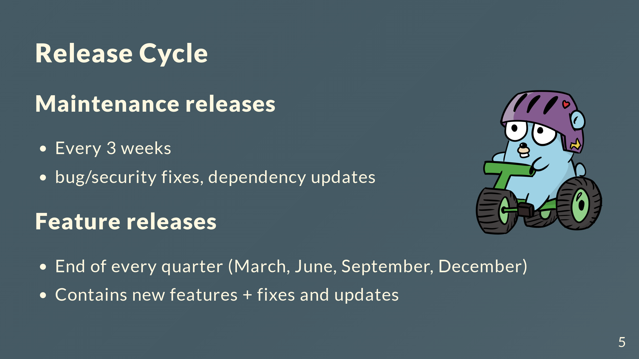

Slide 6
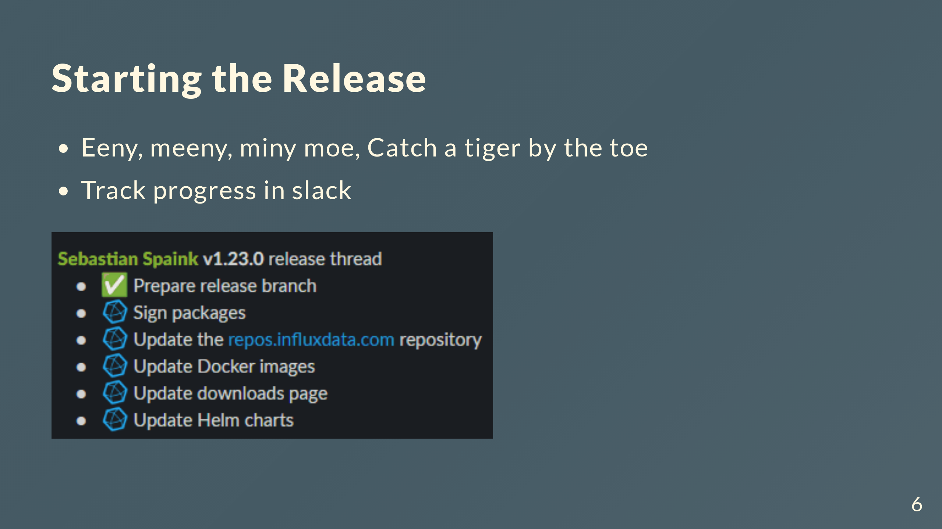

Slide 7


Slide 8


